Slide 1

TOPPERSPLANET
Minor Project I
Submitted by:
SHUBHAM SISODIA (9917103172)
SANCHIT RAJ (9917103193)
KISHAN KUMAR GUPTA (9917103185)
Under the supervision of:
DR. SHAILESH KUMAR
Department of CSE/IT
Jaypee Institute of Information Technology University, Noida
NOVEMBER 2019
Arrangement of Contents : SRS REPORT , PPT

Slide 2
ACKNOWLEDGEMENT
I would like to place on record my deep sense of gratitude to
Dr. Shailesh Kumar Sir , Jaypee Institute of Information Technology for his generous guidance, help and useful suggestions.
I express my sincere gratitude to Dr. Raju Pal Sir and Dr. Swati Gupta Mam (Dept. of Computer Science) for their stimulating guidance, continuous encouragement and supervision throughout the course of present work.
I also wish to extend my thanks to my friends and other classmates for their insightful comments and constructive suggestions to improve the quality of this project work.
Signature(s) of Students
Shubham Sisodia (9917103172)
Sanchit Raj (9917103193)
Kishan Kumar Gupta (9917103185)

Slide 3
Table of Contents
Abstract i
1. Introduction 1
1.1 Purpose 1
1.2 Document Conventions 1
1.3 Intended Audience and Reading Suggestions 1
1.4 Project Scope 2
1.5 References 2
2. Background studies
2.1 Product Perspective 3
2.2 Product Features 3
2.3 User Classes and Characteristics 3
2.4 Operating Environment 3
2.5 Design and Implementation Constraints 3
2.6 User Documentation 4
2.7 Assumptions and Dependencies 4
3. External Interface Requirements 4
3.1 User Interfaces 4
3.2 Hardware Interfaces 4
3.3 Software Interfaces 4
3.4 Communications Interfaces 4

Slide 4
4. System Features 4
4.1 System Feature 4
5. Other Nonfunctional Requirements 5
5.1 Performance Requirements 5
5.2 Safety Requirements 5
5.3 SecurityRequirement 5
5.4 Software Quality Attributes 5
6. Detail Design 6-7
7.Implementation 8-9
7.1 Site structure design 8
7.2 Presentation design 9
7.3 Logical data design 9
Testing 10
Conclusion of the report 11

Slide 5
ABSTRACT
With increasing demands and cheap prices of internet, it is now affordable by one and all and is now nearly in everyone’s hand. Every Household today has either smartphone or PC or laptop. In today’s competitive world when there is a lot of stress on a student for their studies. The primary thing that a student want is a well describe, well efficient and a systematic study material which can guide them to reach their goals. In order to solve the problem we have design a website which will take care of all the requirement of the student.
Here we have tried to provide every ncert e-books to the students along with the download option. We also have design a separate web page which will contain a well described video lectures of each and every topic. This website will also test the knowledge of the student through test series.
We have hosted the web page through XAMPP and have created and design the web pages using HTML and CSS respectively. In order to provide e-books to the student we have uploaded all the ncert books in the respective web page. We also have created a login signup system using database connectivity so that our regular user can enjoy more comforts. Java script is also been used for form validation process.
For checking the outcome of the knowledge gain by a student,we have orgainise a profer test series for them with a user friendly interface.
The main aim was to develop a web site, which will be user friendly and this report will show all those stages through which are project have gone through, in order to reach the goal.

Slide 6
Introduction
1.1 Purpose
The software described in this document is the https://www.toppersplanet.com/ website and associated support pages. This document seeks to provide the Software Requirements Specifications for the educational Website. The purpose of this document is to record the requirements for the design and development of educational Website. This web site was created on sep 2019.There may be a need for future updates of the website. The document reflects the current requirements of the project as understood by the project team. This document presents an initial description of the various functionalities and services provided by the software. The document will also serve the basis for acceptance testing by the user.
The scope of the website is not only limited to attracting and encouraging senior secondary students to take coursework at this website. But it also aims to provide information about the site keeping in mind that the person visiting this website wants a full knowledge of the website.
1.2 Document Conventions
There are no standard document requirements for this document.
1.3 Intended Audience and Reading Suggestions
Primary readers of this document are the web designers contributing to and testing of the college website.
The remaining sections of this SRS describe the functional requirements for educational site.

Slide 7
1.4 Project Scope
The scope of the website is to provide a high school teen friendly set of web pages that are easy to navigate and at the same time provides sufficient depth and information about different topics.
Potential groups of viewers exist:
1) Students who are preparing for board exams for class 11 &12.
2) Students who are aspiring to give competitive exams like Jee Mains , Jee Advance etc.
The goal of website is to encourage more students to use this site.
Maintaining a teen friendly site is deemed of highest importance in order to hold student attention and guide the viewer to information that will lead to a bright future of the students.
Benefits for using the site should include:
Well described video lectures of different topics by the best faculties of different subjects.
Ncert books along with solution are available for students.
To test the knowledge and to see the outcomes test series
are being provided to the students.

Slide 8
1.5 References
None
2. Background studies
2.1 Product Perspective.
Website is aimed toward students who have completed their class 10 and are looking for guidance to overcome challenges that will come in their way in coming 2 years.
Website should be user-friendly, ‘quick to learn’ for the above purpose.
2.2 Product Features
Major features of the website include the following pages/subsections:
Download: Any e-books can be downloaded by student free of cost.
Video lectures: Proper video lectures are available for the students for each and every topic.
Test series: In order to test themselves , a student can join a test series which will contain best questions covering every topic.

Slide 9
2.3 User Classes and Characteristics
There are mainly two types of user:
1. Typical School students that are interested in scoring good in board exams.
2. Students who are focusing more on competitive exams.
2.4 Operating Environment
The site runs on college servers
2.5 Design and Implementation Constraints
There are no Design and Implementation Constraints
2.6 User Documentation
There are no user documents.
2.7 Assumptions and Dependencies
There are no development assumptions or dependencies.
3. External Interface Requirements
3.1 User Interfaces
The website should work and be tested against IE, Firefox, Google Chrome and
Netscape.
3.2 Hardware Interfaces
There are no special hardware interface requirements

Slide 10
3.3 Software Interfaces
Software requirements of the system are very nominal and no other special
requirement is there hence it is economically feasible. Also Java is open source
and thus easily available free of cost.
3.4 Communications Interfaces
There are no special communication interface requirements
4. System Features
4.1 System Feature
4.1.1 Description and Priority
Maintaining a teen friendly site is deemed of highest priority in order to hold student attention and guide the student in the right path.
4.1.2 Functional Requirements
There are no special functional requirements
Very obvious: internet connection

Slide 11
5. Other Nonfunctional Requirements
5.1 Performance Requirements
The website should be hosted on a server that can provide adequate response time. High school students tend to have short attentions spans, so a slow server would not be satisfactory for this application. The current college (www.toppersplanet.ac.in) site is a good example of rapid response time.
16-bit computer.
Minimum 5 GB HDD
Pentium III processor, 500 MHz
Minimum 256 MB RAM
5.2 Safety Requirements
There are no special safety requirements
5.3 Security Requirements
Copyright and other security measures for educational website should be the same as the any of the site.
5.4 Software Quality Attributes
Web design conventions should be consistent with the standards and conventions used on the educational website

Slide 12
6.Detailed design
6.1 Detail design process
Information Gathering is the most important part in web development. Here we have all the important e-books, video lectures and previous year question paper.
The main aim of the site is to help student through giving them access to all those facilities that any coaching could provide to them. Although they study in school or any coaching but self study is very much important .
So in order to help them in their self study, We wish to develop this web site. This website consist of separate pages for video lectures, e-books and test series.
This website has design in very systematic way. Design part has been done with CSS CODE and HTML is used to create Web pages. To design a web page the most important thing is that you must be clear of what you are doing.
The design part is also essential because the first impression that the user will make of the website is by seeing the layout of the site whether it has been arrange in a systematic or not.
We have developed separate webpages for e-books, video lectures and test series.
There is also a signup and login page design to make user more comfortable.

Slide 13
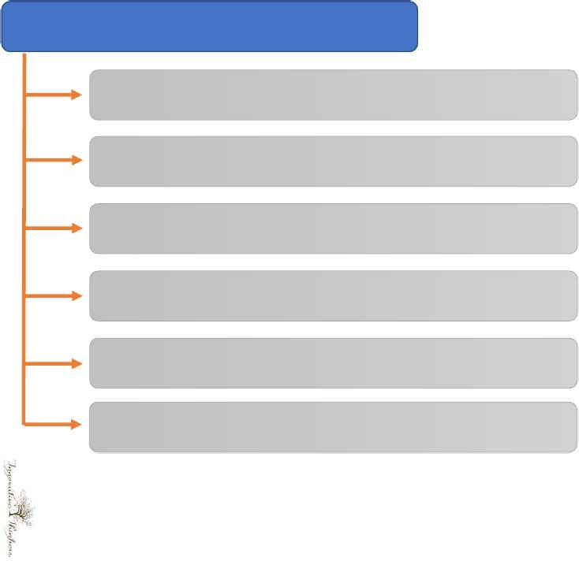
VARIOUS STEPS INVOLVED IN
DESIGNING
DESIGN
1.Discuss the main concept of graphic design
2.Draft version of graphic design
3.Review draft graphic design
4.Make final version of graphic design
5.Approve the graphic design
6.Milestone meeting
7

Slide 14
7. Implementation
Implementation Design is the complementary phase to the descriptive design phase for concept and navigation.
Please remember that the processes described within this series are definitely not complete. Thus, the Implementation Design will deal mainly with three steps:
Site Structure Design
Presentation Design
Logical Data Design
7.1 Site structure design
This step is to distribute the components found in the conceptual design in a manner that is friendly to the audience(students) as well as logical in its semantic contents. Remember that the WSDM is a user centric approach and therefore all design decisions need to be done with the audience and users' behavior in mind. This point may be difficult from the view of the project manager because he cannot predict the future behavior of the website's audience. Thus, his decisions have to be made on a very speculative basis. The technical aspects are of a more solid nature because there are alternatives that can simply be weighed by technical, financial, or any other calculable reasons. The user's behavior cannot be calculated.

Slide 15
7.2 Presentation design
The main task is to create the look and feel of the site, and to utilize a layout that is in line with the audience and the mission of the website.
We have used templates that is highly recommended to ensure consistent design, reduce the amount of testing, increase the speed of building, and to do so using (semi)automated generation of code and graphic components.
Templates are good for layout elements and whole pages, as well as for parts of a page like tables, controls, special functions, etc.
7.3 Logical data design
A website has to present information. All information is split off into different parts, single chunks that are presented using the whole tool set we get from psychology.
Creating an ontology for the provided information is the main step in the logical data design phase.
Creating ontologies can be supported using different techniques and some common tools.
Here we have design different web pages for e-books, video lectures links and test series. Our main aim was to provide data in a very systematic way.
So that user don’t have to waste time for searching anything.

Slide 16
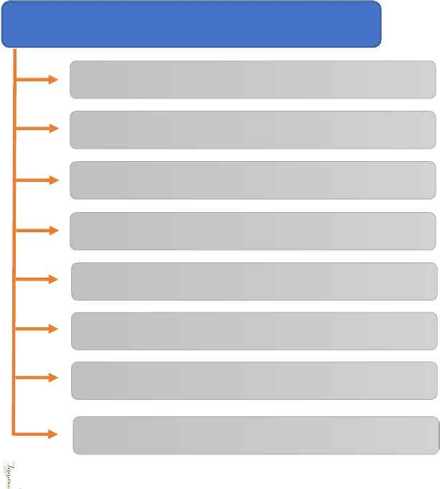
esting
6.1 Functionality Test6.2 User Interface Main Site6.3 Security Test6.4 Speed Test6.5 Web Traffic & Load Test6.6 User Impression Test6.7 Speed Test6.8 Milestone Meeting
8. Testing Reports:
In order to develop our educational site in to a informative, accessible and user-friendly site , the website should be well tested.
Here we have tested our XAMPP, database connectivity and other functions which are very essential for loading our site. We also have checked our database entry through signup and login process. The download option for e-books are also been tested and also been cross checked. We found 0% error in all of the above cases. Clicking on video links are also been cross checked.
TESTING
1.Functionality test
2.User interface main site
3.Security test
4.Speed test
5.Web traffic and load test
6.User impression test
7.Speed test
8.Milestone meeting

Slide 17
9.Conclusion of the report:-
After going through all of the above processes, we have made a website which has been developed for convenience of user(students).
We have use XAMPP for hosting the site. HTML and CSS are being used for creating and designing the web pages.
In order to satisfy our requirement we have seen all the functional and non functional requirements. For being user friendly designing and implementing part have been done keeping in mind the user.
At last the testing part has been also done carefully and have been cross checked twice.
After loging into this site we are providing everything to a student that any reputed coaching can provide whether it is study material, e-books, descriptive tutorials of different topic by professionally polished faculties or the conductance of a test series.
END

Slide 18
PRESENTATION OF WEBSITE
“TOPPERSPLANET”
PROBLEM STATEMENT
With increasing demands and cheap prices of internet, it is now affordable by one and all and is now nearly in everyone’s hand. Every Household today has either smartphones or PC or laptop.
In today’s competitive world when there is a lot of stress on a student for their studies.
The primary thing that a student want is a well describe, well efficient and a systematic study material which can guide them to reach their goals.
Now days it has become a myth that u can crack any competitive exam or can score good in your board exams only if you have access to any coaching class.
There is also a common problem among students that after studying certain topics how they can test themselves that how much they have learnt.
So in order to overcome this they think of joining test series as the only option.

Slide 19
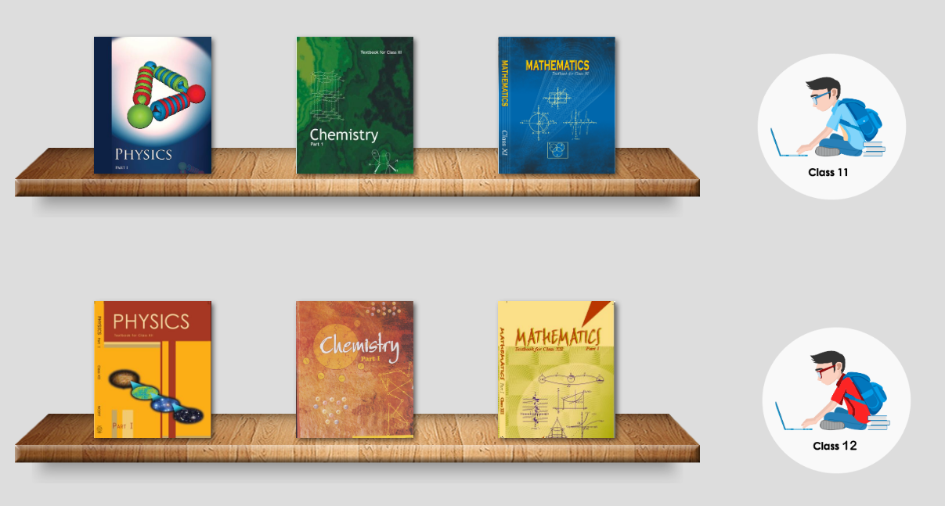
STATE OF ART AND THEIR LIMITATIONS
E-books:
In this website we have uploaded ncert books of all the primary subjects.
We have also given some additional features to it such as zoom in ,zoom out etc.
There is also an download option to it. If a student want to read the book in a place where network is not so good than he could simply download so that in future he could use it anywhere.
Limitation:
A good network connection is required to download the book

Slide 20
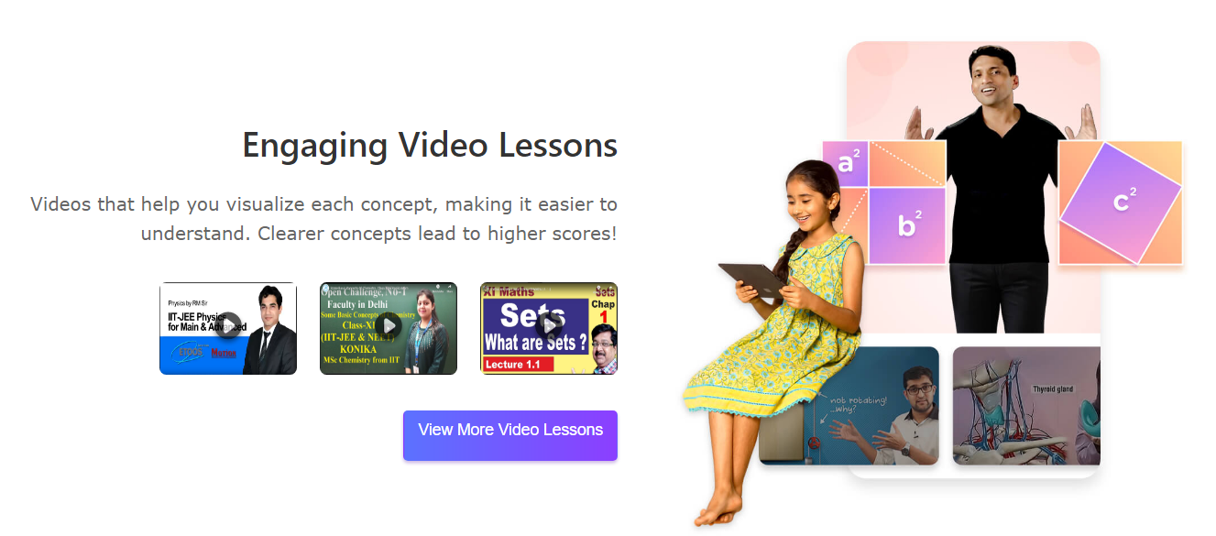
Videos:
For making students more familiar to the concepts, a well described video lectures has been uploaded so that their study could be more efficient.
The videos has been developed in a very structure way so that students do not have to waste more time for searching any topics.
There are few demo videos available for all students and after that to continue seeing more videos a login signup functions are created so that we can take input from the users.
Limitation:
A student can only watch demo videos if he have not signup.

Slide 21
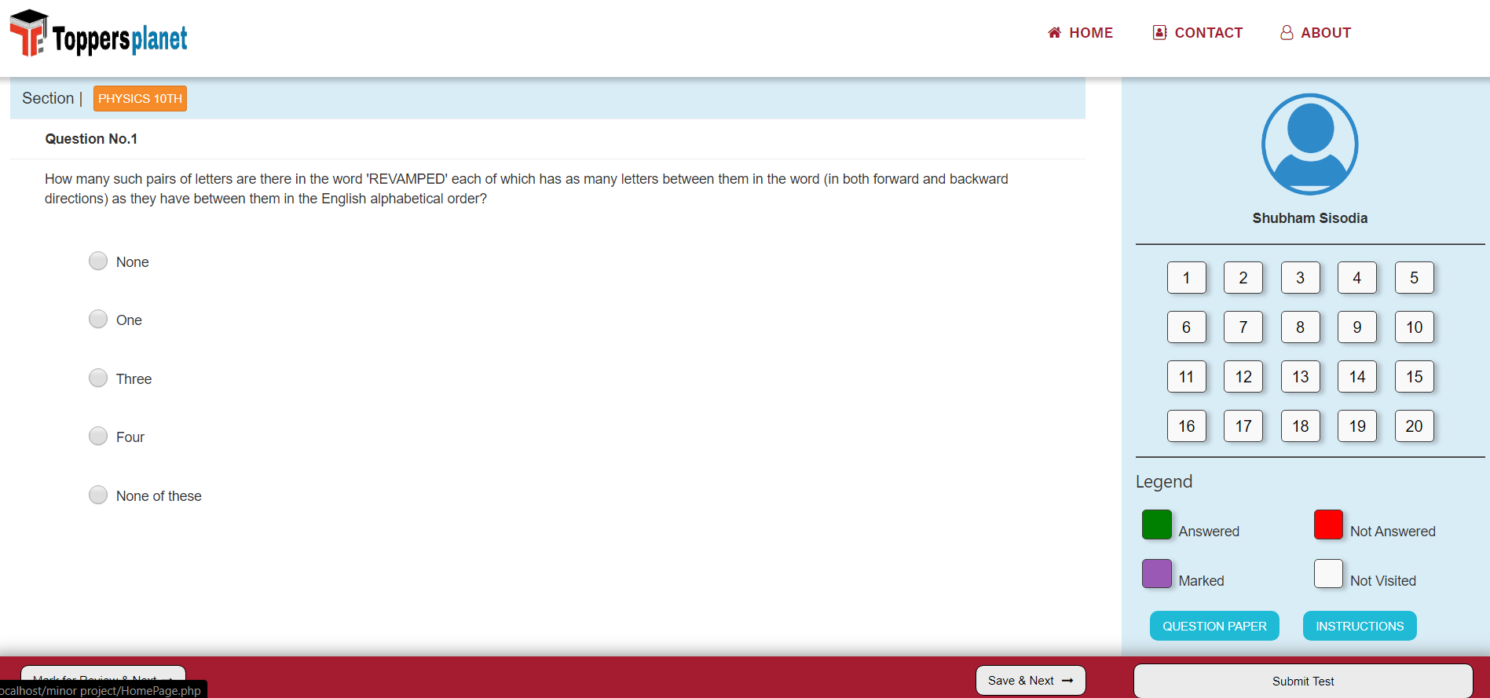
OBJECTIVE AND WORK DISTRIBUTION
So there is always a question in minds of every parent and student that is it necessary to join coaching classes to be successful in exams. So from this project we are planning to offer every students all those comforts that a coaching class can provide .Through our website they can study text books, can watch well describe videos for important topics and can also test their knowledge through various test series. The main aim is to provide every possible help and groom all the students in a systematic way.
We have used XAAMP to host the web pages. Web page are being created and design by HTML and CSS respectively. MY SQL is being used for database connectivity

Slide 22
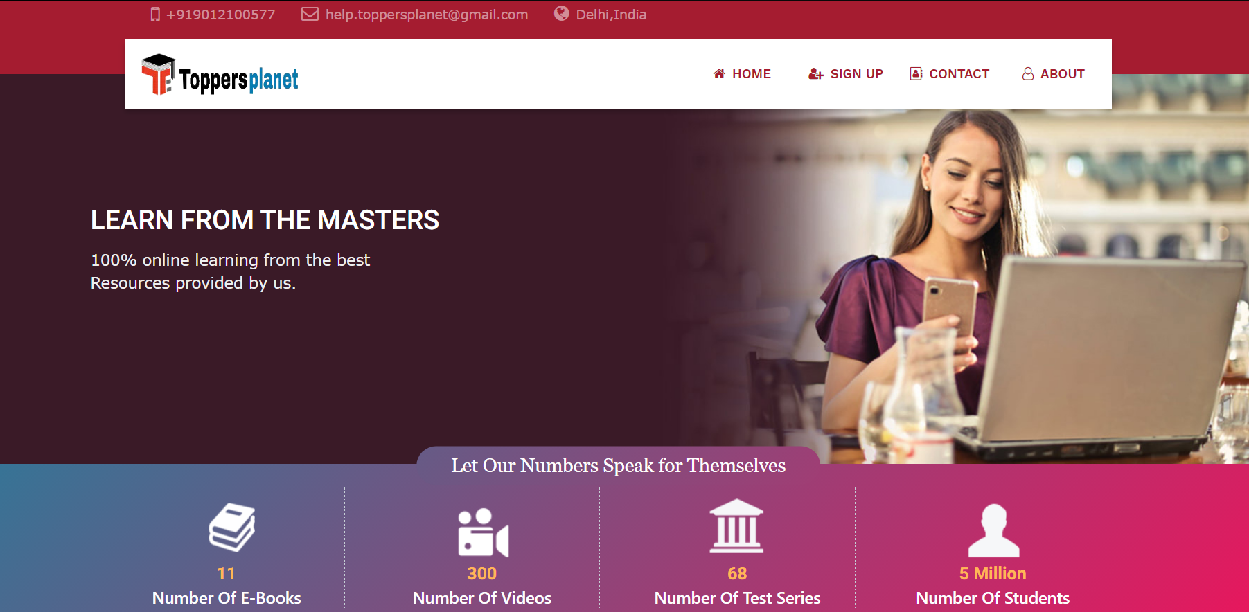
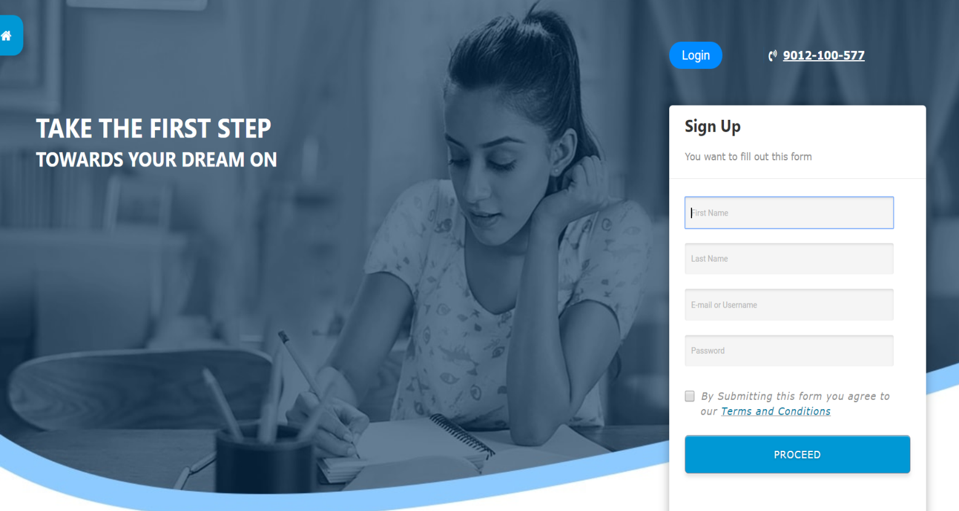
PROPOSED DESIGN / SOLUTION
HOMEPAGE
SIGNUP

Slide 23
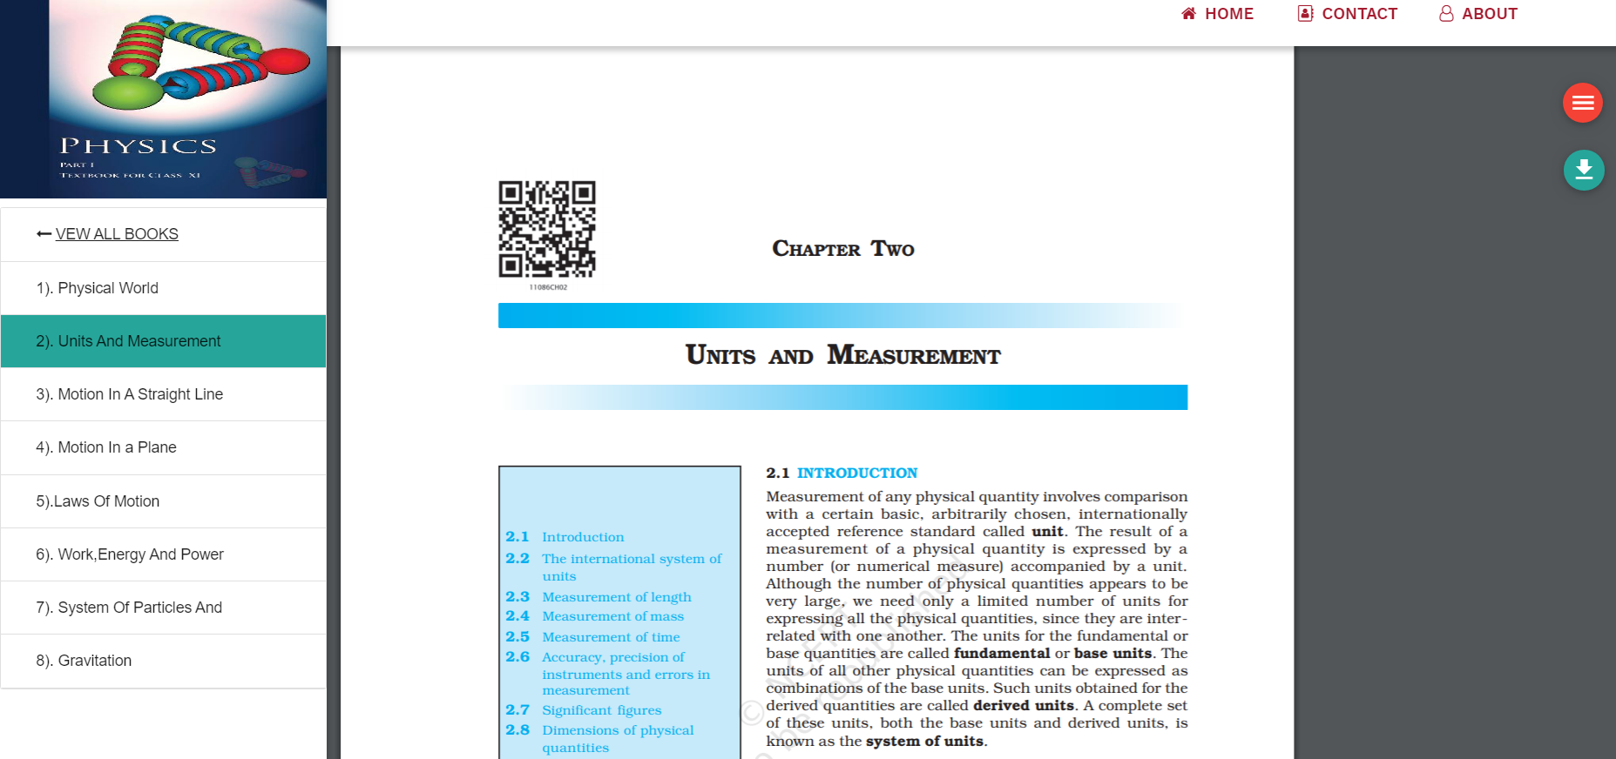
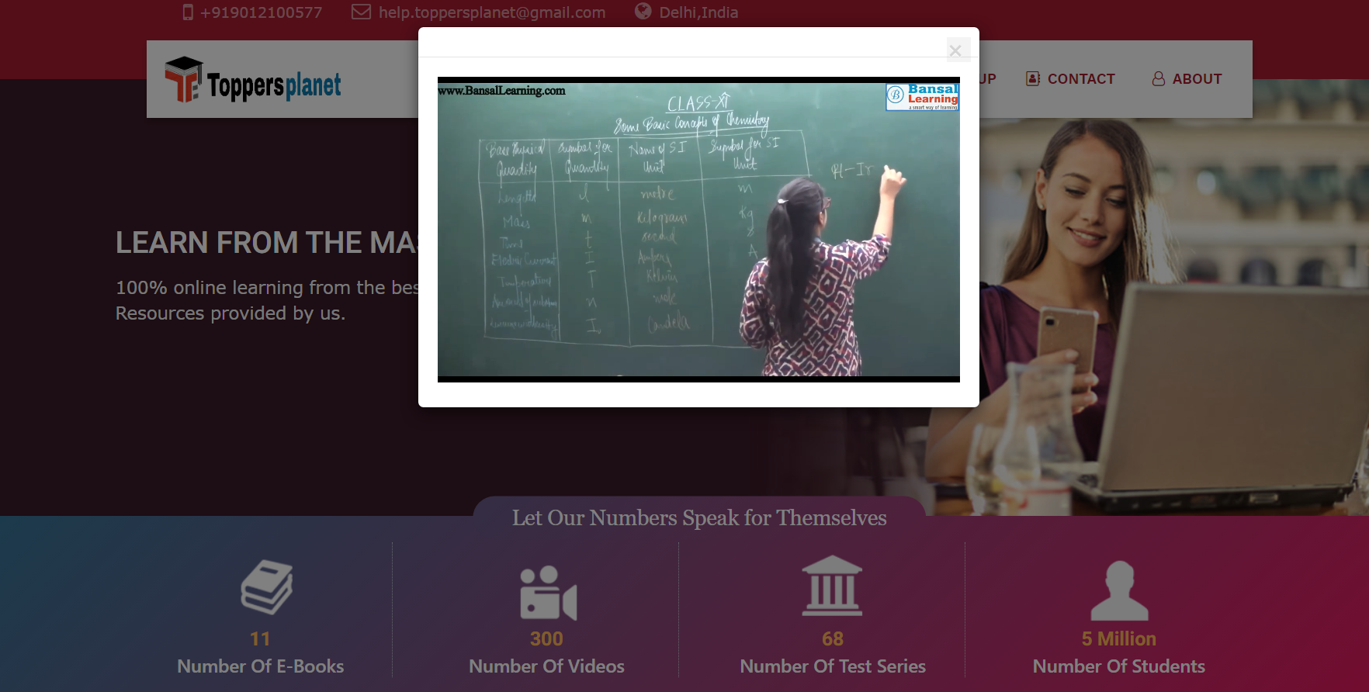
E-BOOK PAGE
VIDEO LECTURE

Slide 24
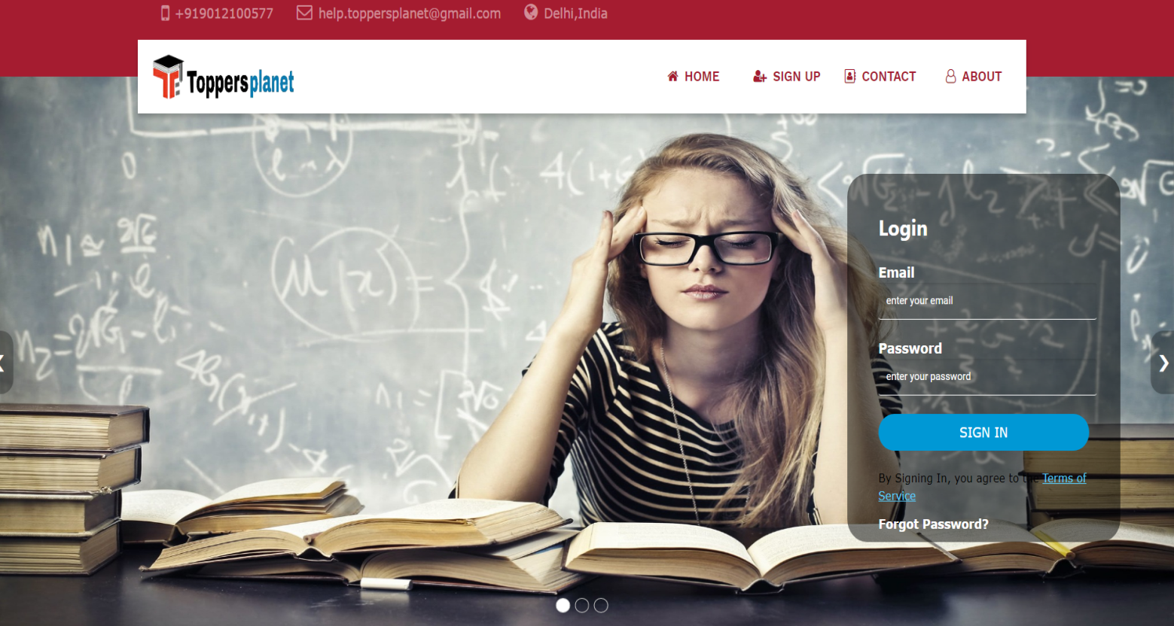
RESULTS AND ANALYSIS
After going through all the process we found:
We have tries to create a user friendly interface through which they can access the resource in systematic way. This project has been created keeping in mind the convenience of the students.
Here a login/sign up page has been created where any student can register or sign up.
A page containing important videos covering all topics that can be viewable only after login(some demo videos are available for everyone). .
A page containing e books for every subject which any student can access to without log in.
Download option is also available.
Test series is also been organised with separate pages for different subjects.
In order to make test series attracting and user friendly we have marked different cases with different colour.

Slide 25
CONCLUSION OF THE REPORT
After going through all of the above processes, we have made a website which has been developed for convenience of user(students).
We have use XAMPP for hosting the site. HTML and CSS, are being used for creating and designing the web pages.
In order to satisfy our requirement we have seen all the functional and non functional requirements.
For being user friendly designing and implementing part have been done keeping in mind the user comfort zone
.
At last the testing part has been also done carefully and have been cross checked twice i.e we have checked the downloaded file with the original file.
Working of videos and log in sign in process are also been tested properly.
Test series is also been organised with separate pages for different subjects and are checked with every possible answers.
In order to make test series attracting and user friendly we have marked different cases with different colour and colour have been checked for different answers.

